Slide 1
Project Title : ESPN Cric Info Web Scraping

Slide 2


Agenda
A
1. Problem Statement
2. Tools Used
3. Approaches
4. Ideas: what can be done using this collected dataset
5. Summary

Slide 3
Problem Statement
This project aims to mine and analyze T20 cricket player data from the ESPN Cricinfo website, focusing on players aged 40 or below.The extracted data will be structured and analyzed to provide insights for strategic planning and decision-making in the upcoming Indian Premier League (IPL) and T20 World Cup

Slide 4
Tools Used
Python – for data extraction and cleaning
Selenium – for web scraping
Streamlit – for create a user-friendly web application
for data analysis

Slide 5
Approaches
Create a UI :
- provides an intuitive interface for users to extract AllRounder and T20 player data.
- Also. we can segregate the players into female and male players so that we can create Men or Women Cricket Team
- Also. There is a feature to extract players based on age, to determine who can play in U-19 team and who can qualify for national team.
Data Scraping
Links
Links :
UI
Used Selenium : to open “ESPNCricInfo” website and extract players of category “AllRounders” and “T20s”.
For All Cricketers : https://www.espncricinfo.com/cricketers
For Each Cricketer :
https://www.espncricinfo.com/cricketers/ravichandran-ashwin-26421/bowling-batting-stats
Data Cleaning and Structuring
Raw or Unstructured Data: Store them in CSV Format
Personnel Details
All stats related to T20 players and AllRound
Player Link ( url for each player)

Slide 6
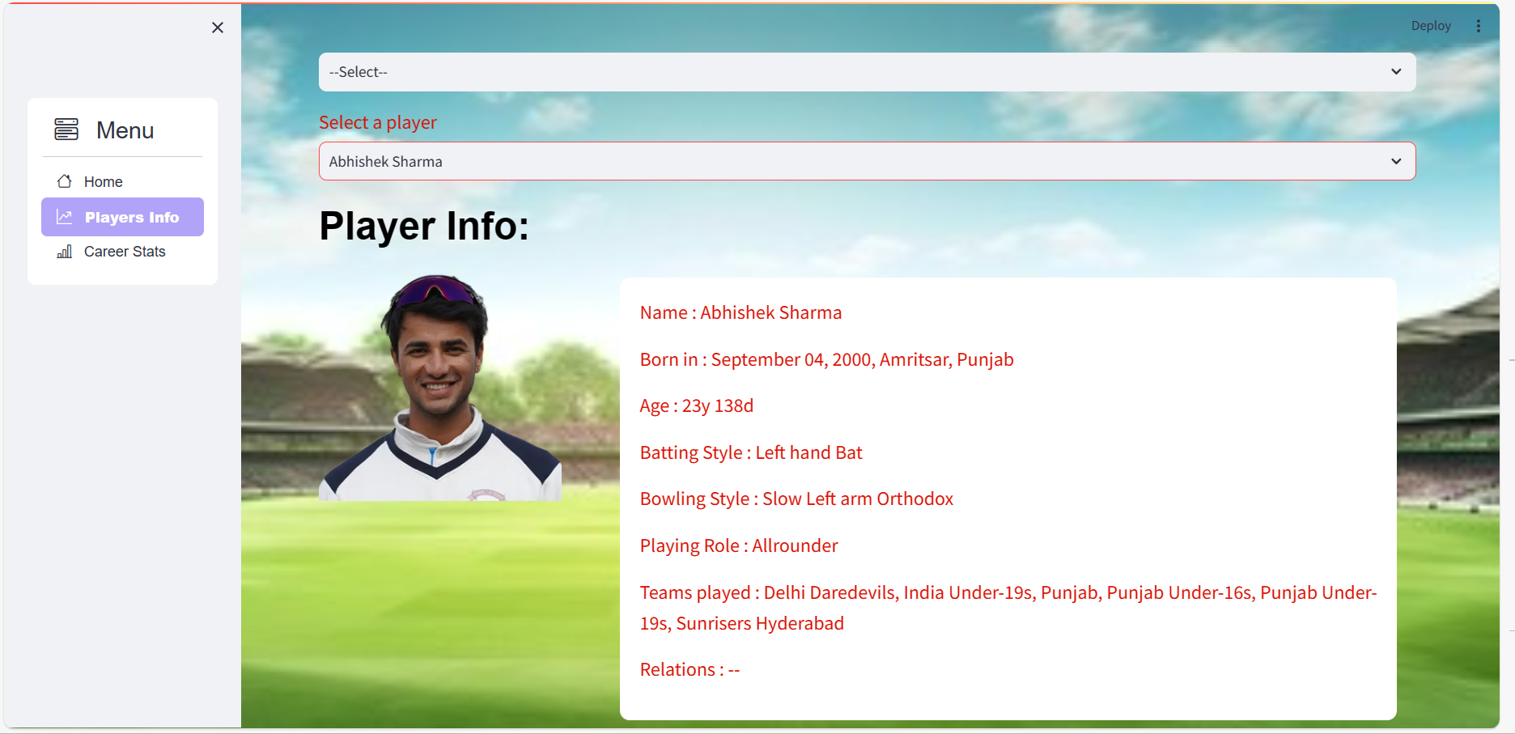





Player Info
Takuma Hayashi​
Mirjam Nilsson​
Flora Berggren​
President
Chief Executive Officer
Chief Operations Officer
Graham Barnes
Rowan Murphy
Elizabeth Moore
VP Product
SEO Strategist
Product Designer

Slide 7
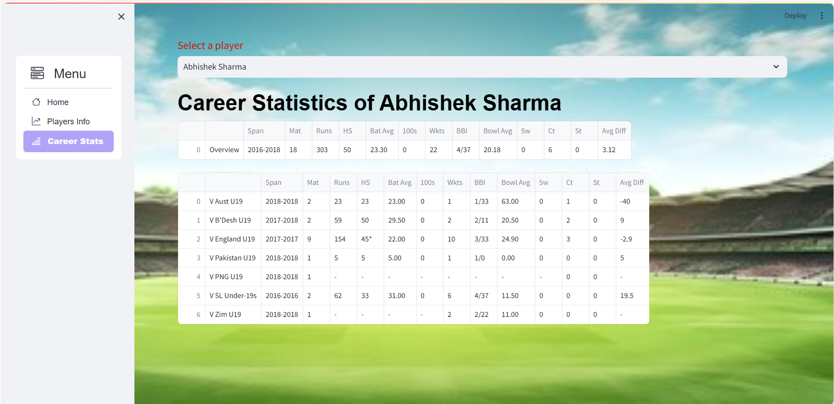
Career Stats
Takuma Hayashi​
Mirjam Nilsson​
Flora Berggren​
President
Chief Executive Officer
Chief Operations Officer
Graham Barnes
Rowan Murphy
Elizabeth Moore
VP Product
SEO Strategist
Product Designer

Slide 8
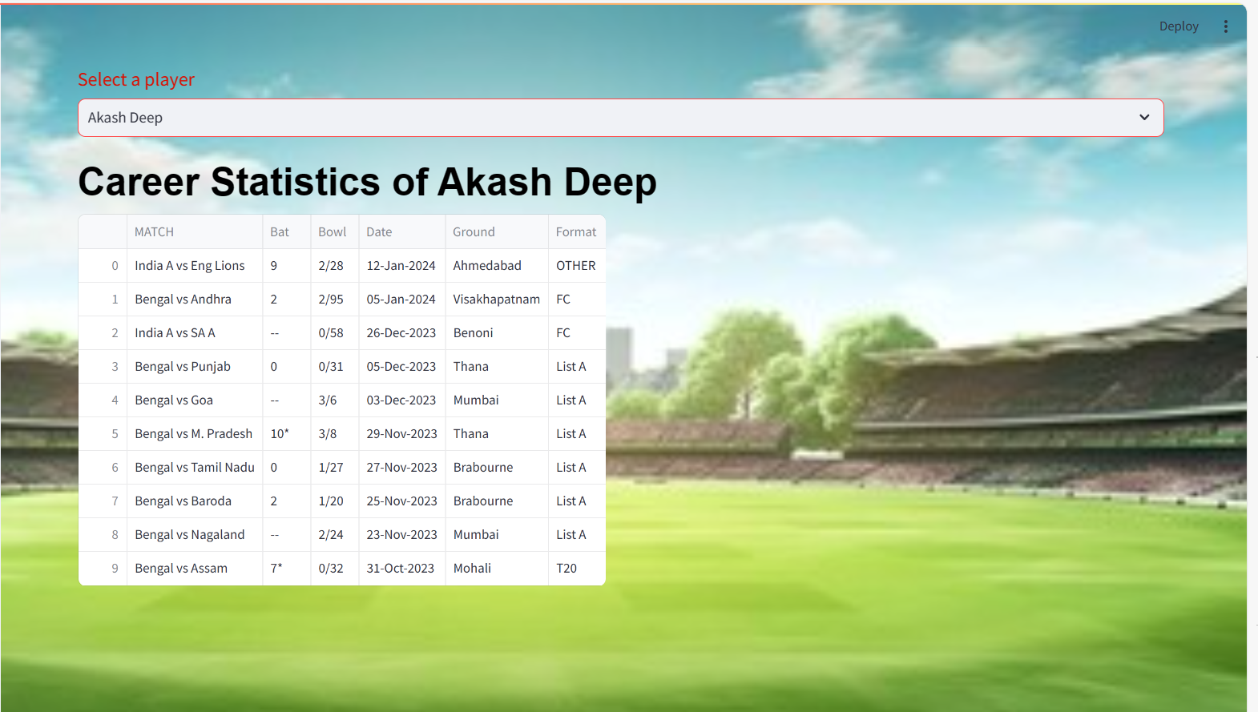
Recent Matches Played
Takuma Hayashi​
Mirjam Nilsson​
Flora Berggren​
President
Chief Executive Officer
Chief Operations Officer
Graham Barnes
Rowan Murphy
Elizabeth Moore
VP Product
SEO Strategist
Product Designer

Slide 9
What can be done with the dataset
AllRounders and T20s Dataset
Male and Female Players Dataset
Age based Dataset
Country wise Dataset
We get the URL Links for each player
Get the age of each player
Select only those players whose age is 40 or below 40
Select players who are Actively playing so that we can form a team for upcoming IPL and T20 World Cup
Create structured data based on gender
Create separate teams for Men Cricket Team and Women Cricket Team
This dataset helps us to get an estimate of active players of different age categories
This dataset helps to create a team for U-19 Men or U-19 Women teams
This dataset helps to create a team for National Men or National Women teams for IPL or World Cup
This dataset helps us to get players for different countries
It is divided into AllRounders or T20s , so we can get these types of players for each of the active countries like Australia, New Zealand , England etc.

Slide 10
What can be done with the dataset
Career Stats Dataset for Each Player
This dataset helps us to get the performance of each player
We are getting it in the form of 2 features -- Stats
-- Matches
For some players, we are getting Stats Info from the Player Profile. So, we are extracting the data from Stats section for them.
For some players, there is no “Stats” section present , so we are going to “Matches” section and extract the matches played, Runs and Wickets and all relevant info.

Slide 11
Areas of focus
F
setting an option to download each of the player details.
option kept to segregate the players with highest runs and maintaining different lists of players who can kept in front rows
players who have taken maximum wickets

Slide 12
Summary
This app tries to extract the player details for “AllRounder” and “T20” category and store them in csv files.
This app can be improvised by setting an option to download each of the player details.
Also, there can be an option kept to segregate the players with highest runs and maintaining different lists of players who can kept in front rows, players who have taken maximum wickets can be selected for National Team and so on.

Slide 13
Thank you
Created by
- Aastha Mukherjee

